Slide 1
ATAI
Chongqing University of Technology
Advanced Technique of Artificial Intelligence
Chongqing University of Technology
2020KDD@GPT-GNN: Generative Pre-Training of Graph Neural Networks
Binyan Zhang
157657348@qq.com
2020.07.16 • HeNan

Slide 2
Outline
Background
Motivation
Approach
Experiments
Conclusion

Slide 3
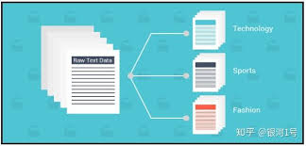
Background
1、Training GNNs usually requires abundant task-specific labeled data;
2、 Large amounts of high-quality supervised data are very expensive.

Slide 4
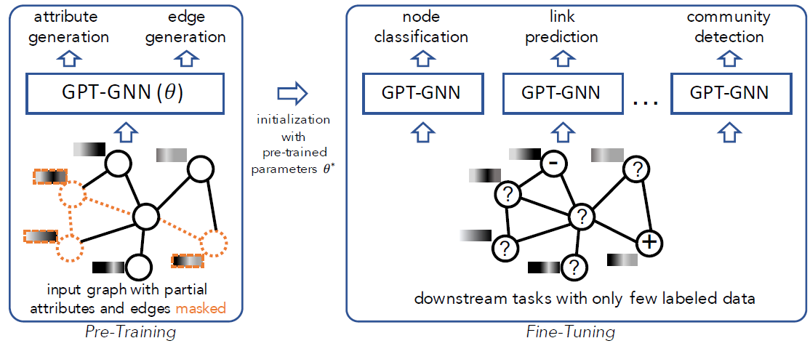
Motivation
First, most of them can’t capture the
underlying patterns between node
attributes and graph structure.
Second, they are designed to handle
small graphs to date, limiting their pot-
ential to pre-train on large-scale graphs.

Slide 5
Approach
Input:

Slide 6
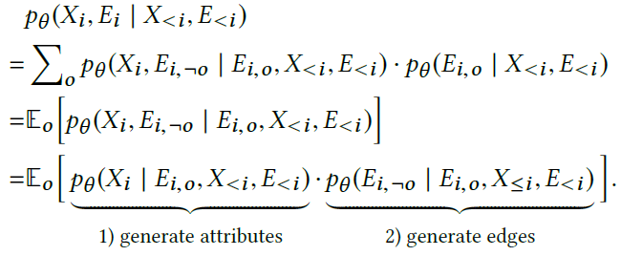
Approach

Slide 7
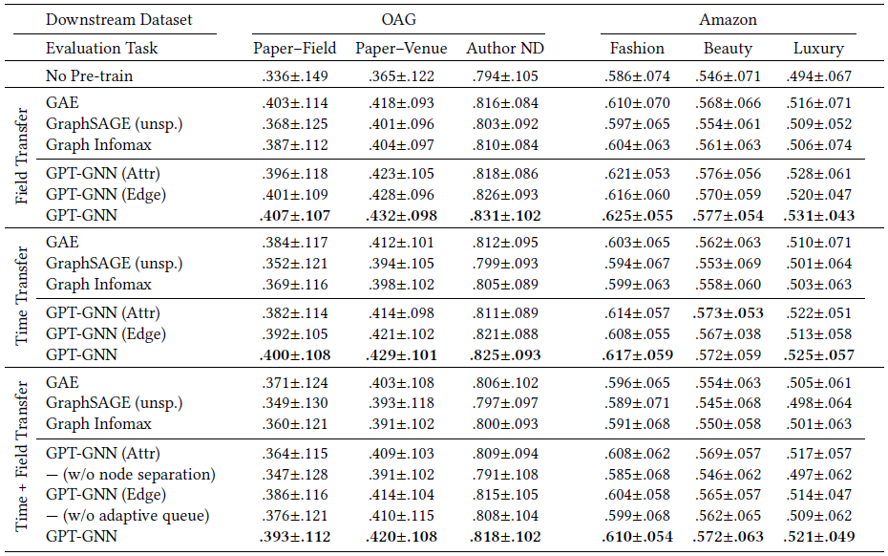
Experiments

Slide 8
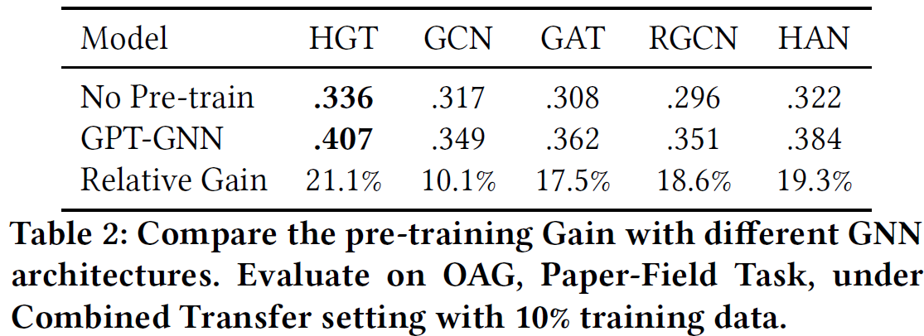
Experiments

Slide 9
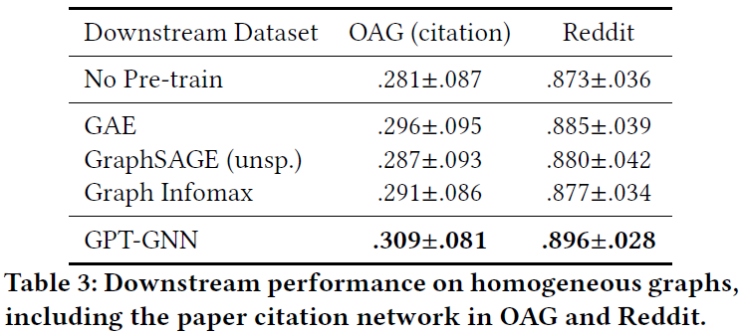
Experiments

Slide 10
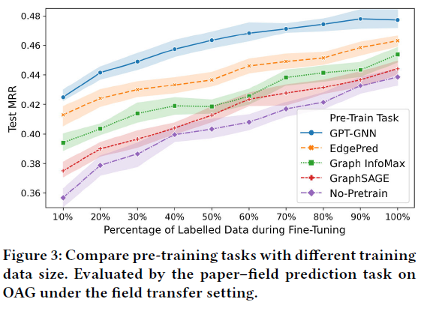
Experiments

Slide 11
Conclusion

Slide 12
Experiments

Slide 13
Experiments

Slide 14
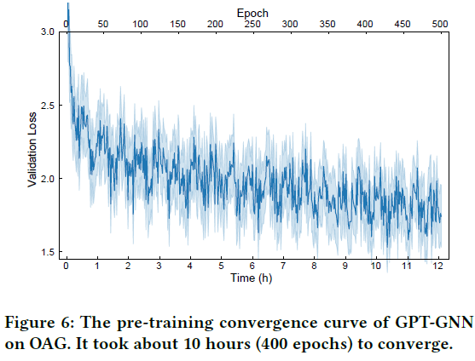
Experiments

Slide 15
Conclusion
First, this paper design an attributed graph generation task to model both node attributes and graph structure.
Second, we propose an efficient framework GPT-GNN to conduct generative pre-training with the aforementioned task.
Finally, we pre-train GNNs on two large-scale graphs—the Open Academic Graph (OAG) of 179 million nodes & 2 billion edges and Amazon recommendation data of 113 million nodes.

